Slide 1
Smart traffic lights
Done by:

Slide 2
Methods

Slide 3
1. How long have you been driving?

Slide 4
2. What is the biggest problem that causes accidents on the road?

Slide 5
3. On a scale from 1 to 5, how safe do you feel on the roads? (5 being the most safe)

Slide 6
4. Do you think the current stoplight system should be improved?

Slide 7
5. On a scale of 1 to 5, 5 being you completely agree with the idea, how much would you like the idea of another light being added to make the stoplight 4 lights instead of 3?

Slide 8
6. Do you think there is room for improvement when it comes to arrows on traffic lights?

Slide 9
7. Would you support the idea of a smart intersection? (Where the intersection would take control of your car and chooses when it stops and goes to prevent accidents)

Slide 10
8. Would you support the idea of changing each light on the traffic light's shape in order to help those who are colorblind?

Slide 11
Intelligent control system
"Smart traffic light" is a system of dynamic control of traffic signals, thanks to which the traffic capacity of the street and road network is improved. First of all, road safety is improved. In other words, this is a traffic light that does not operate in the usual, strictly defined mode, regardless of why, but a traffic light that switches signals based on the number of vehicles in each of the directions.

Slide 12
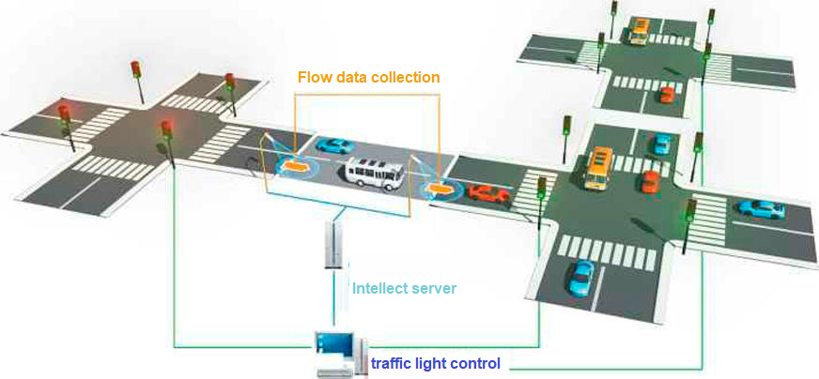
Intelligent control system
The devices will work in tandem with special software and sensors to independently adapt to the traffic situation. Priority will be given to public transport and special vehicles.

Slide 13
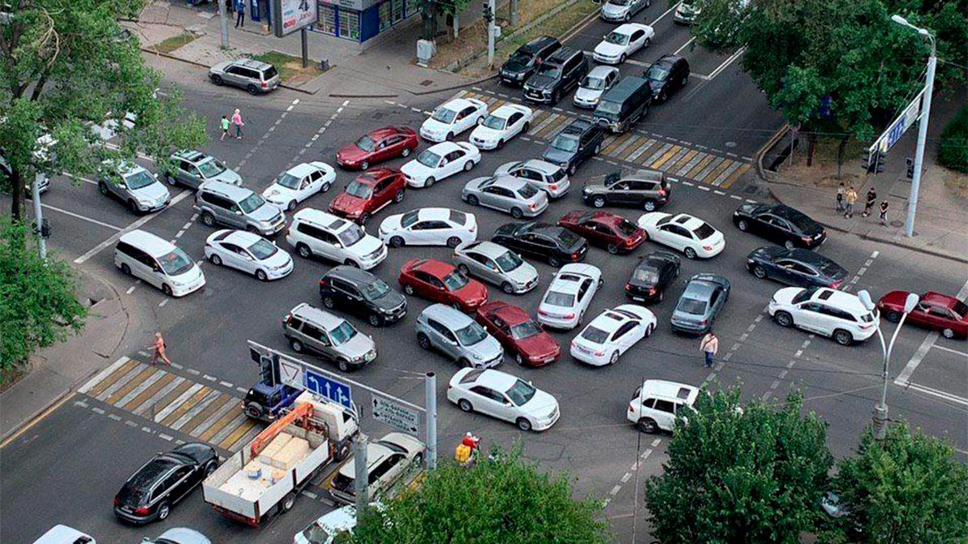
Intelligent control system
With the help of special sensors, new devices are able to see the flow and determine its direction, as well as speed. Based on this information, they will independently regulate traffic, which should help in unloading the roads.

Slide 14
Intelligent control system
Firstly, it is traffic information for statistical processing:
total number of detected vehicles;
speed;
acceleration of traffic flow;
flow density;
traffic lane congestion;
classification of cars.
Secondly, information about accidents on the road:
high speed, flow density or busy lanes;
the presence of congestion or traffic in the oncoming lane;
stopped or slow moving cars;
the presence of suspicious objects on the road .
Third, information about the presence/absence of cars:
the presence of approaching cars;
the presence of cars stopped at the intersection;
number of vehicles passing through detection zones;
measuring the queue length.

Slide 15
RESULTS
Based on the survey, it is possible to identify that the road system has much to develop. Although not all people are ready for change, most still understand that this will positively affect the condition of the roads and protect them.

Slide 16
CONCLUSION

Slide 17
REFERENCES
Chandrasekhar M., Saikrishna C. & Chakradhar B. (2013) «Traffic Control Using Digital Image Processing» , International Journal of Advanced Electrical and Electronics Engineering ISSN 2278-8948.
Ekinhan E. (2017). Optimization of Traffic Signal Timing at Oversaturated Intersections Using Elimination Pairing System, 295 – 300.
Gustav N. & Giacomo C. (2017). «On Generalized Proportional Allocation Policies for Traffic Signal Control», International Federation of Automatic Control, 50-1, 9643–9648.
Nasser R. Sabar , Le Minh Kieu , Edward Chung , Takahiro Tsubota , Paulo Eduardo Maciel de Almeida. (2017). A memetic algorithm for real world multi-intersection traffic signal optimisation problems, 45-53.
Rongrong T. & Xu Zh. (2016). Design and Evaluation of an Adaptive Traffic Signal Control System – A Case Study in Hefei.
Recently Used Worldwide ” International Journal of Futuristic Trends in Engineering and Technology ISSN: 2348-5264 (Print),
S.W. Chiou. (2003). TRANSYT derivatives for area traffic control optimisation with network equilibrium flows, Trans. Res. B. 37 (3) 263–290.
Shailendra T. (2012). «A New Genetic Algorithm Based Lane-By-Pass Approach for Smooth Traffic Flow on Road Network», International Journal of Advanced Research in Artificial Intelligence.
Prof. Jayesh Juremalani and Dr. Krupesh A. (2014). A Critical Appraisal on Traffic Signal Timing Optimization Techniques, ISSN: 2348-4071 (Online)Vol. 1 (06)
https://docs.google.com/forms/d/1Y_1SBi4yJJz4-FwnKNQUPrj2xgafhYORvuA--1bqp-4/edit?usp=sharing

Slide 18
Thank you for attention

